Slide 1

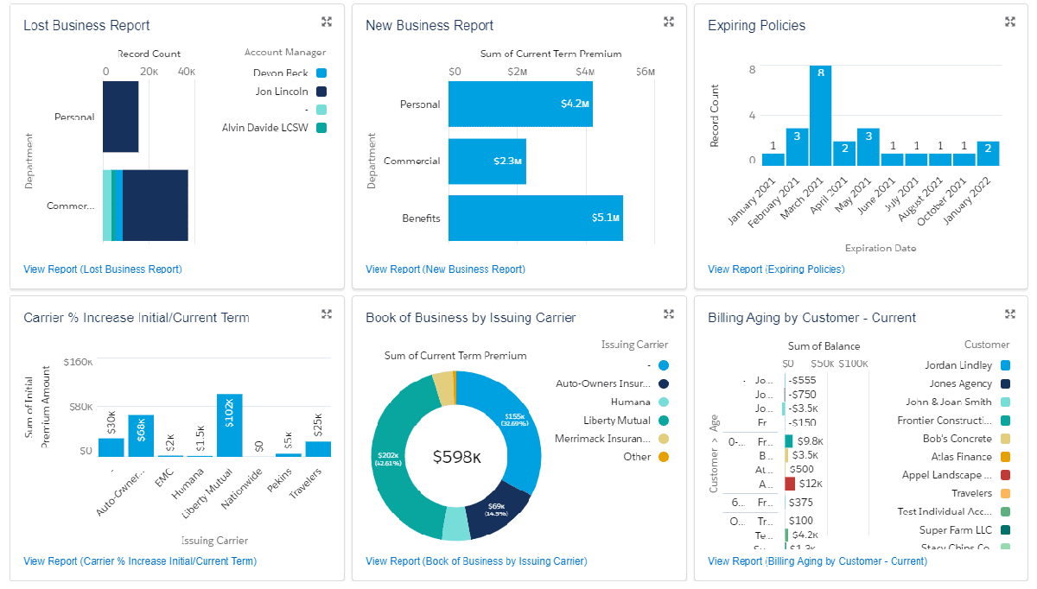







Built on Salesforce, Veruna is the only 100% native agency management system (AMS) that provides real-time updating, carrier downloads, and ACORD forms while integrating mission-critical business KPIs for real-time, actionable insights.
SINCE 2019
PARTNERSHIP FACTS:
Target Industry: Insurance
Target Market: Insurance Distribution (Independent Agencies and Brokers) ***P&C and Benefits in one!***
Target Buyer: COO, CTO, Principal
Target End Users: Agency Leadership, Agents, Brokers
How Veruna Helps You Get Started: Veruna helps bring new customers, sell more seats, and close and implement customers in weeks, not months!
Avg. Sales Cycle: 2-6 months (Veruna brings SPEED—implement in a fraction of the time vs. a traditional AMS)
Avg. Deal Size: 75-125 users
Upsell Opportunity: Experience Cloud, Einstein, Marketing Cloud, Pardot
© 2021 Veruna, Inc. • Internal Use Only
5-star rating!
PAIN POINTS VERUNA SOLVES:
CUSTOMER BENEFITS:
Veruna eliminates the disconnect between sales and policy administration via one, unified system for the entire agency
Legacy AMS can’t answer basic business questions: wins, close rate, retention rate, and profits by carrier. Veruna provides this in real time.
Legacy AMS can’t customize workflows, fields, or dashboards to business needs while Veruna makes this simple
Vital metrics in real-time dashboards: revenue per producer, cost per producer, close rates, and more
Immediate awareness of upsell, cross-sell, and re-market opportunities in the book of business (also via real-time dashboards)
Ability to integrate a wide variety of marketing and sales tools: marketing, telephony, SMS, email campaigns, etc.
Workflow automation: tasks, reminders, remarket opportunities
KEY CUSTOMERS:
LEARN MORE

